Slide 1



Trading Spaces LTSM for SPY
Alpa Sheladia
Will Turner

Slide 2

Algorithmic Trading
Objective:
Using NLP / Logistic Regression to Predict Future Stock Movement
Program that allows a user to choose a company from the S&P 500 as well as SPY run a logistic regression model to predict the price movement of this company's stock on the future trade based on current sentiments of Reuters news articles related to that organization.
This platform performs algorithmic data training using various models to provide best analysis to help traders decide whether to buy or sell the stock.

Slide 3








Data Collections
VIX (Chicago Board Options Exchange ) , SPY S&P500 (The SPDR S&P 500 Trust ETF ), news Articles from NewsAPI, and Tweets from twitter API

Slide 4
Multi Model Utilization for Time Series Prediction ( SPY & VIX)
Load Data.
Define Keras Model.
Compile Keras Model.
Fit Keras Model.
Evaluate Keras Model.
Tie It All Together.
Make Predictions
Tune the Model
Save the Model
Summarize the Model
Separate Train and Test Datasets
Plot Learning Curves
Learn a New Dataset
Use Functional API

Slide 5
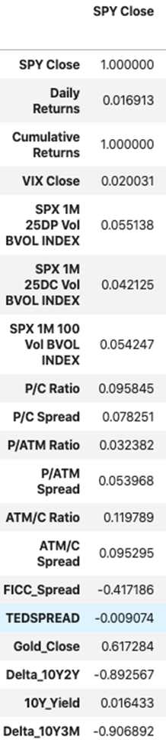
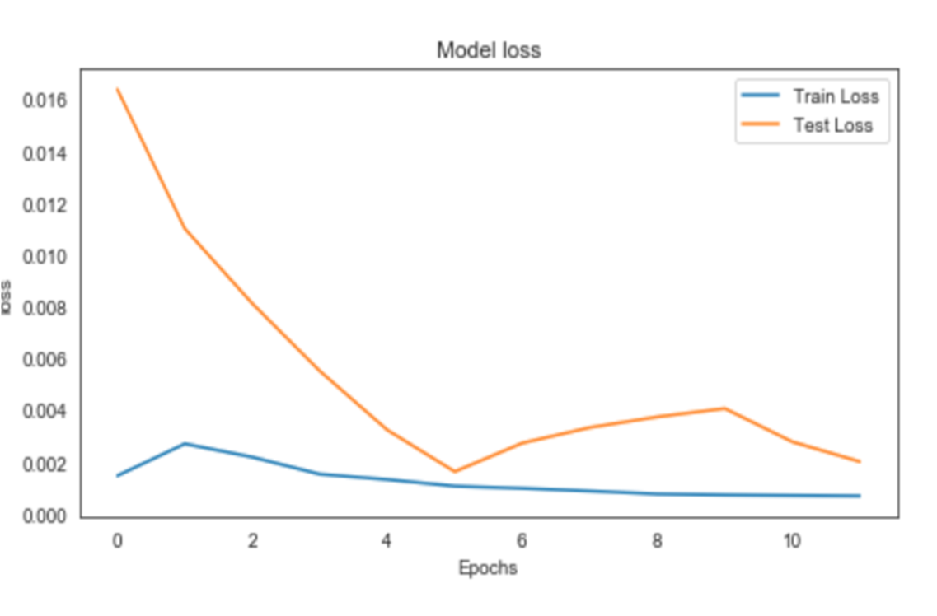
Overfitting/Underfitting Goldilocks Model

Slide 6
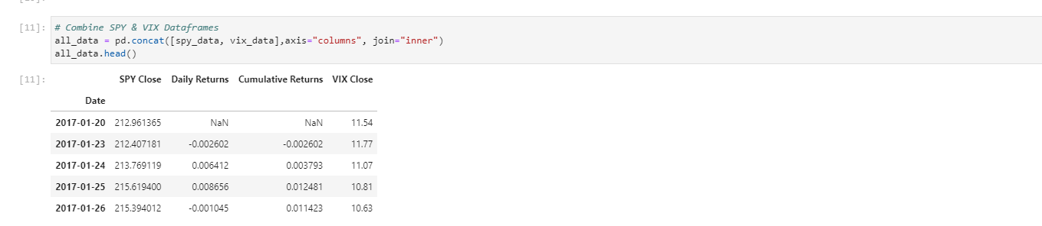
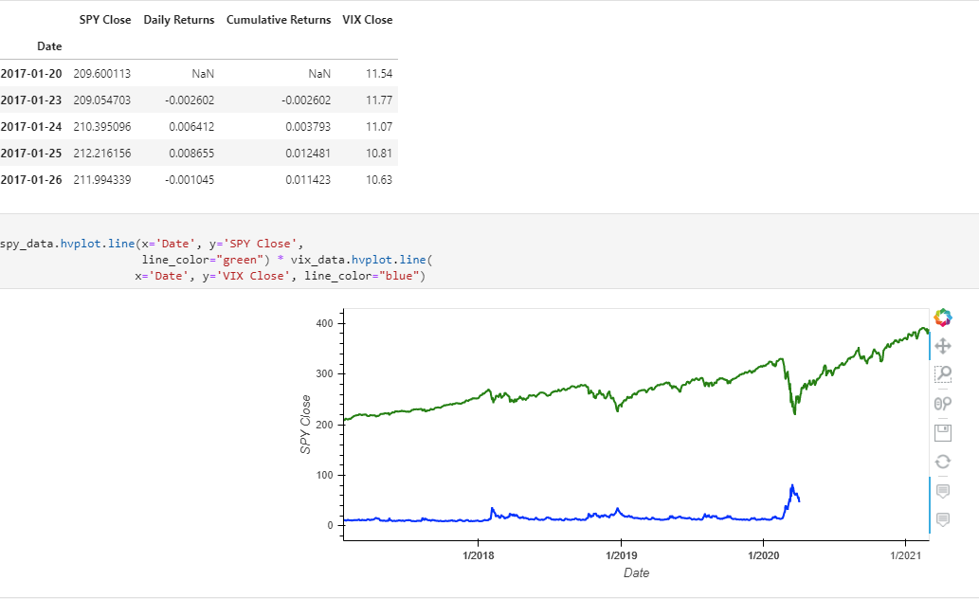
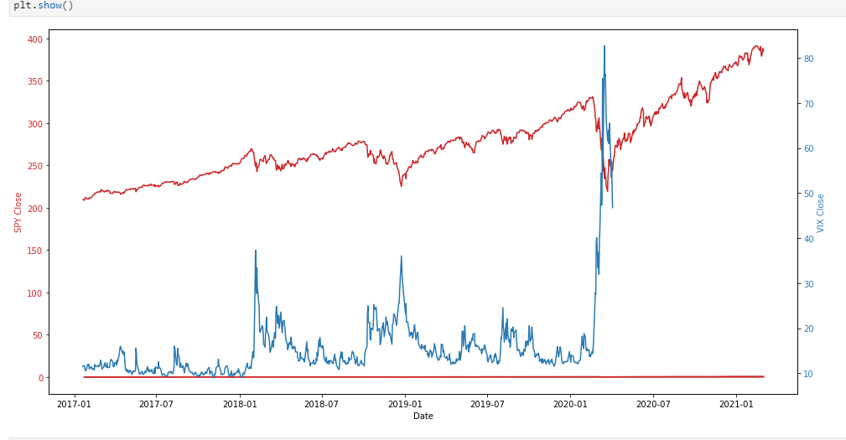
SPY and VIX Data Visualization
Overlay Chart of SPY and VIX
Closing data of SPY vs. VIX

Slide 7
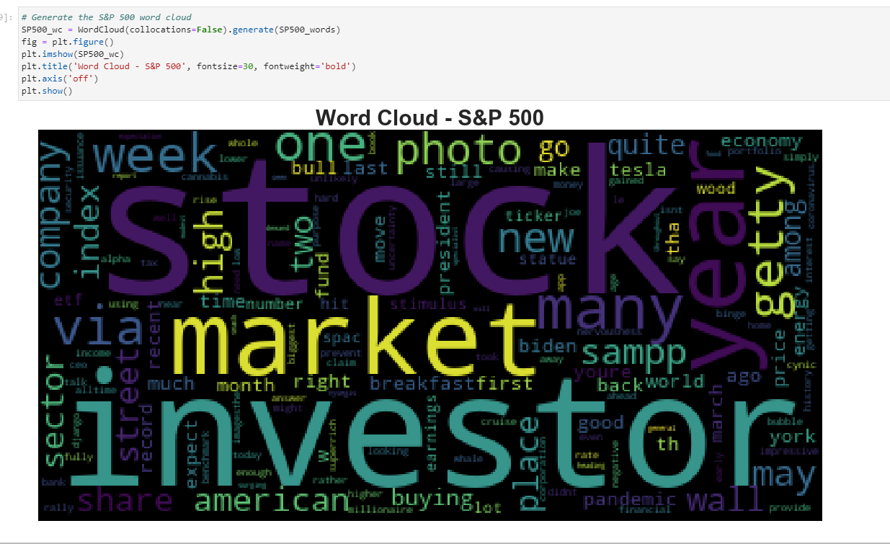
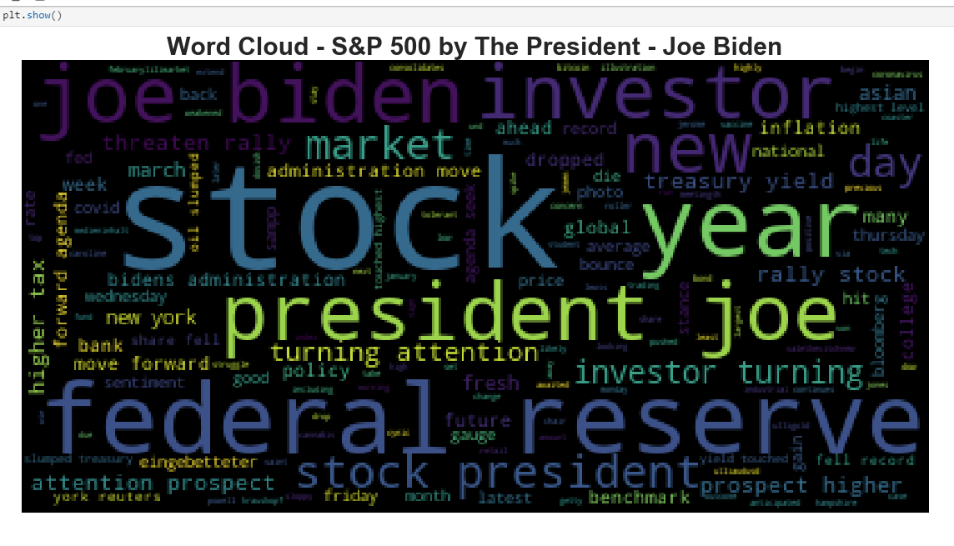
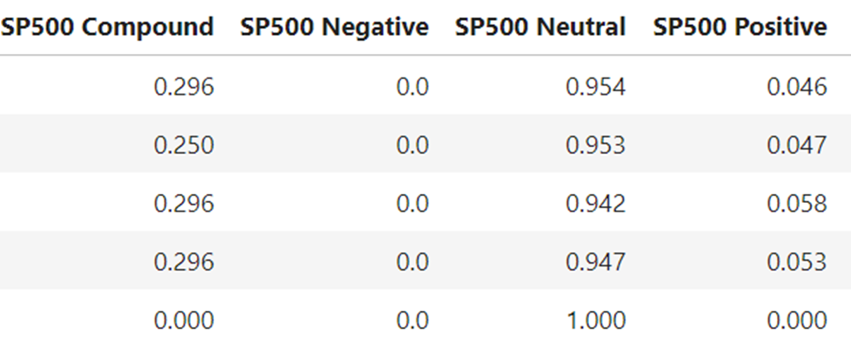
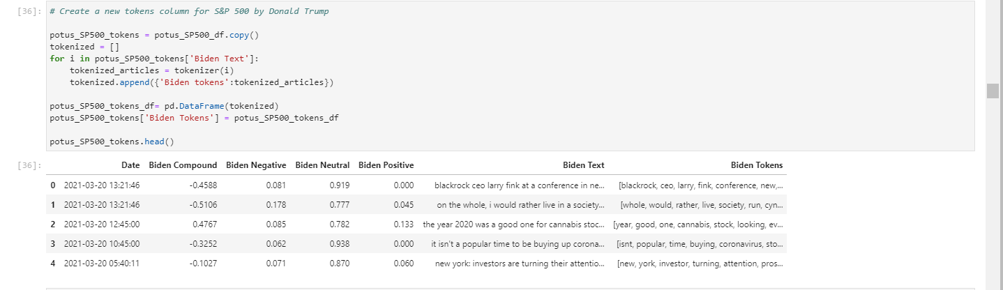
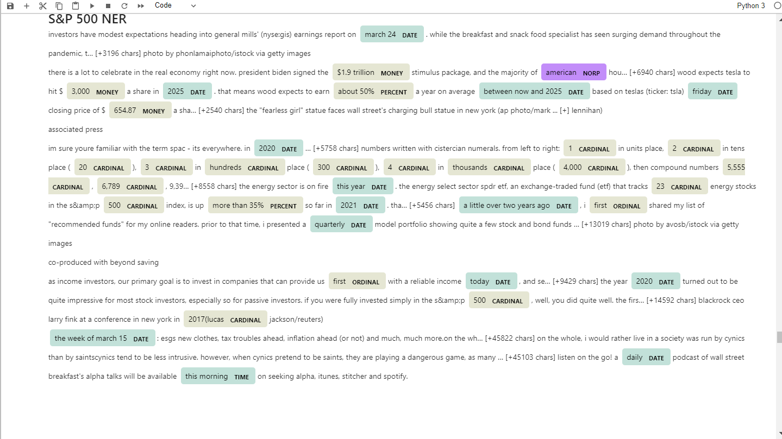
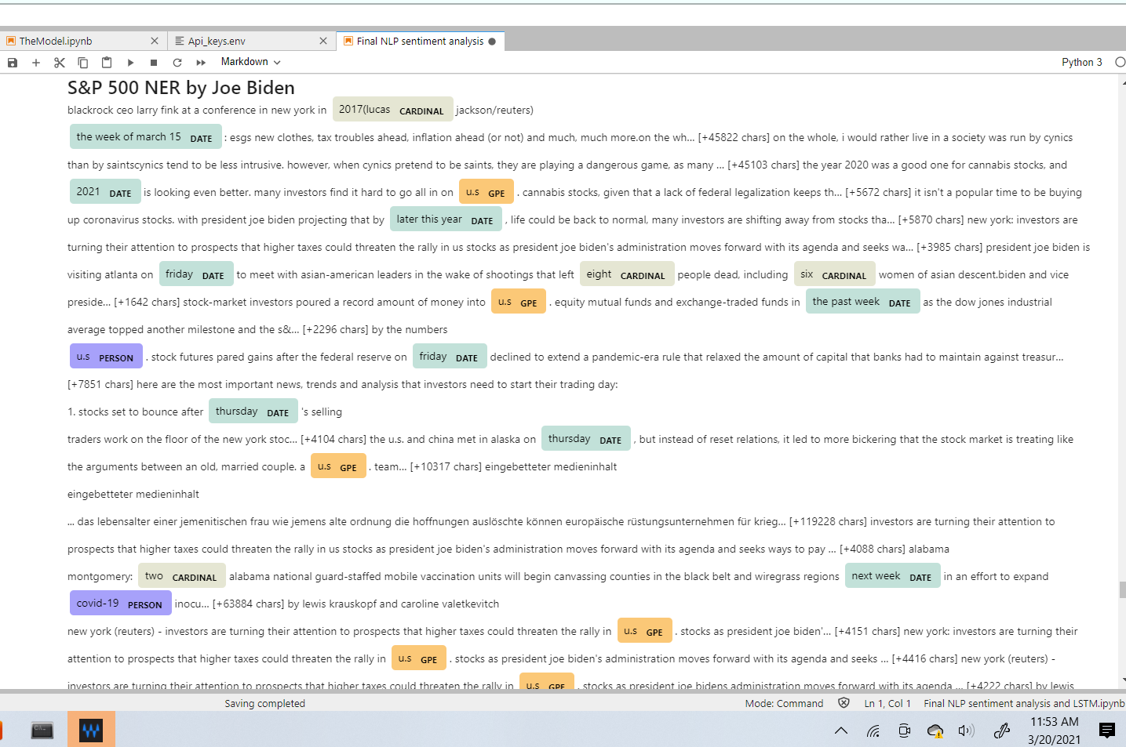
Slide 27
Sentiment Analysis
Word Cloud S&P 500
Word Cloud President Joe Biden

Slide 8
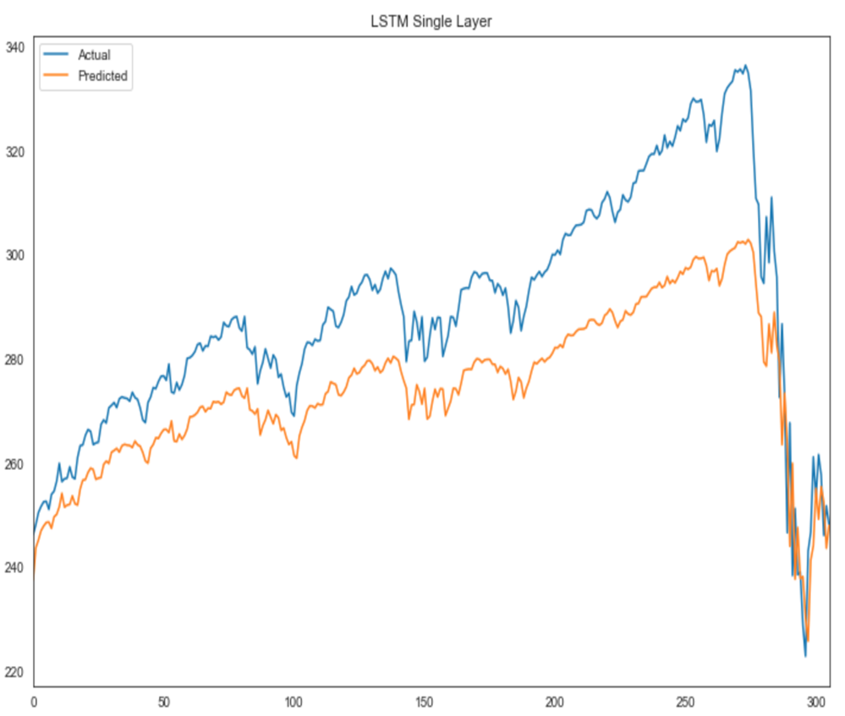
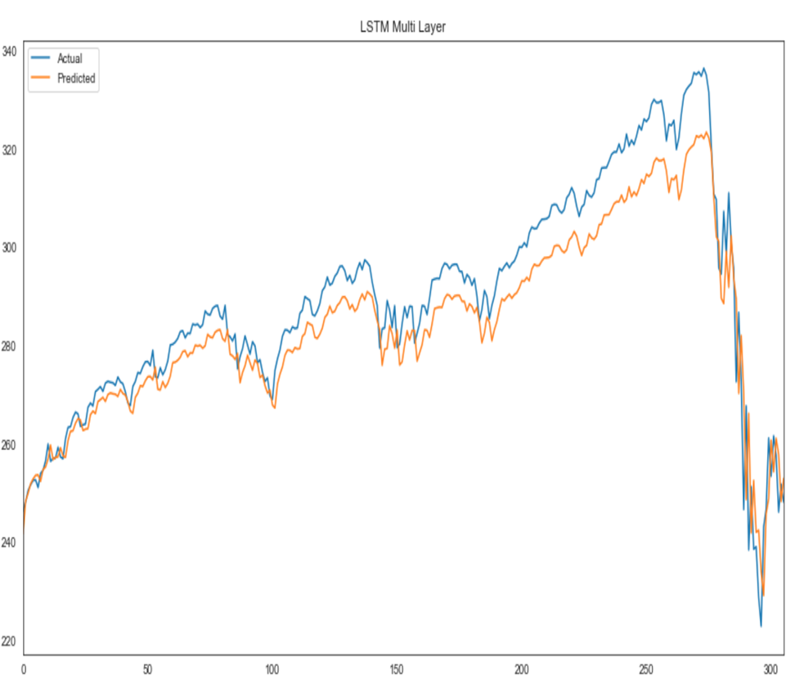
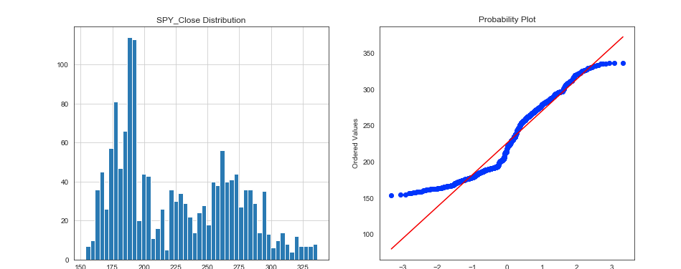
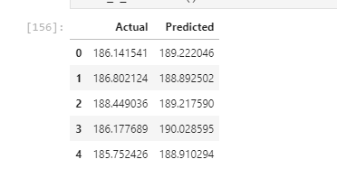
Single Layer – LTSM
Multi- Layer - LTSM

Slide 9
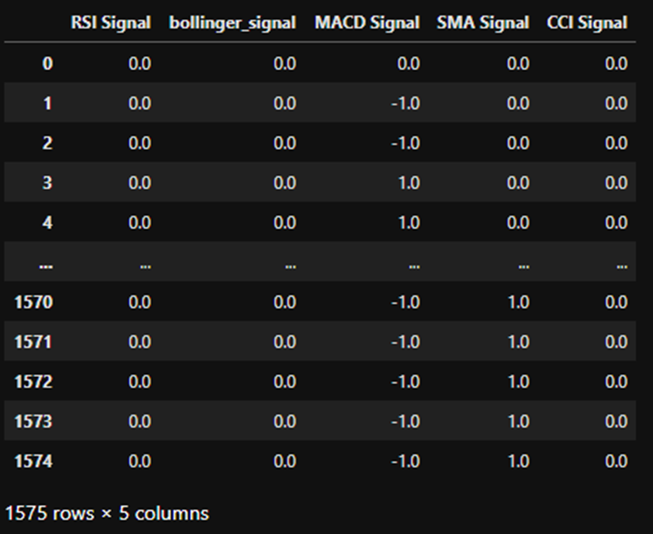
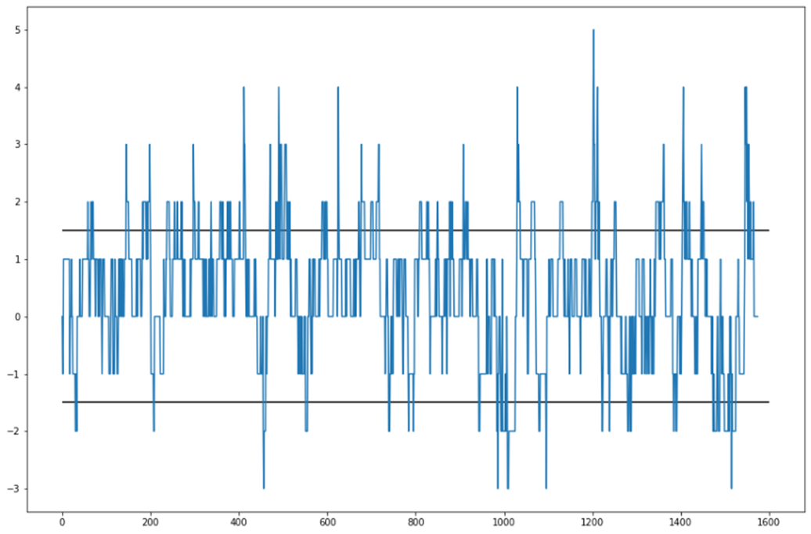
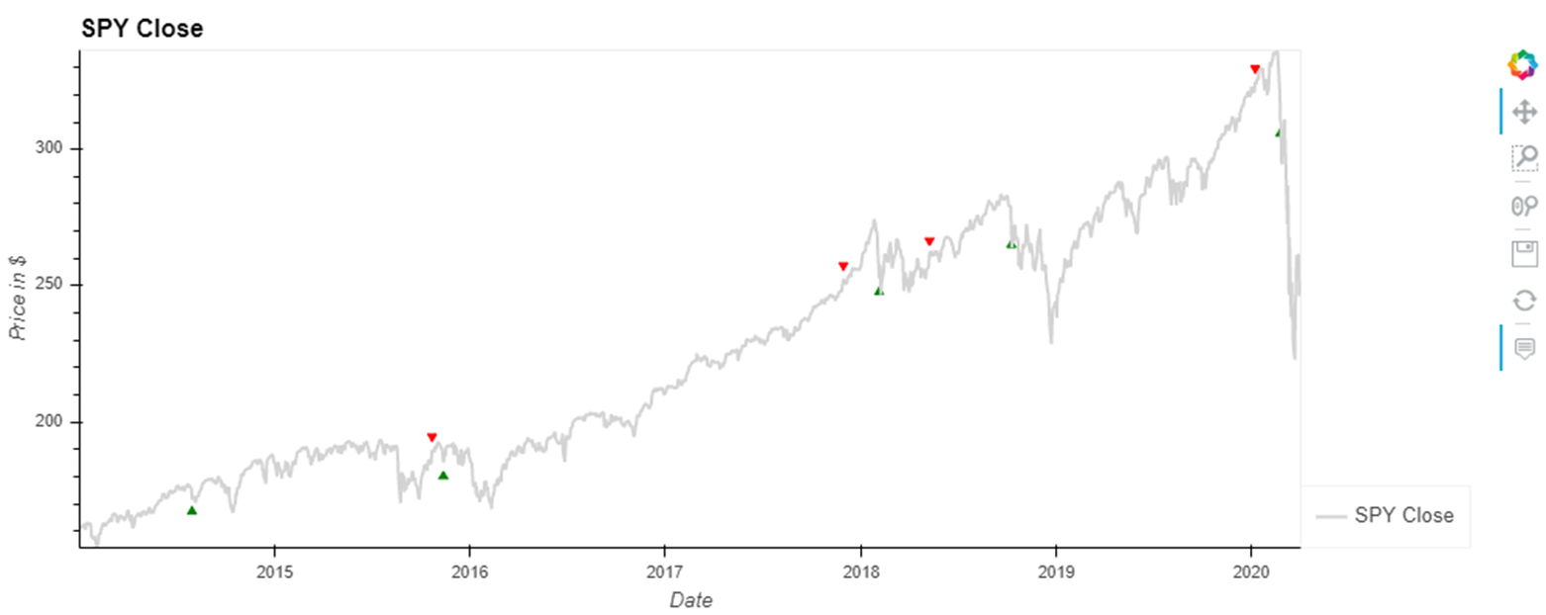
Trading Signals as Input Data
Signals
Generating Signals
Buy/Sells

Slide 10
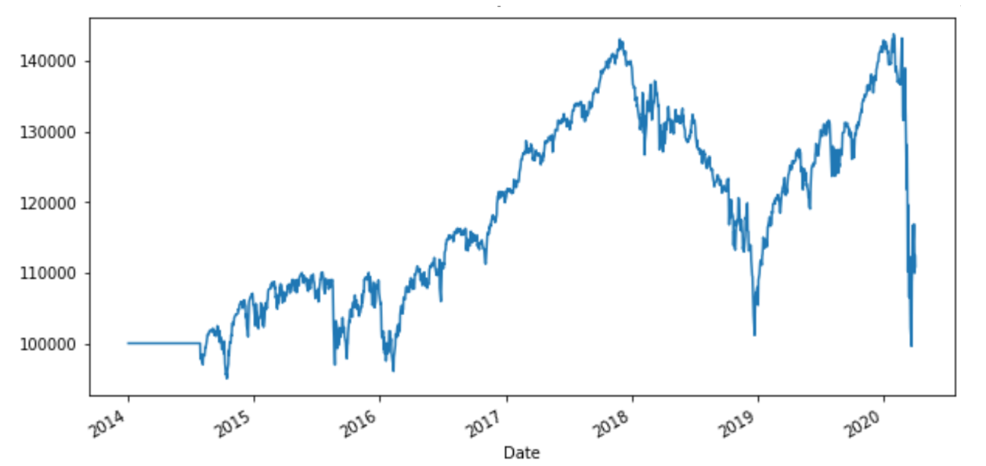
Profit & Loss

Slide 11
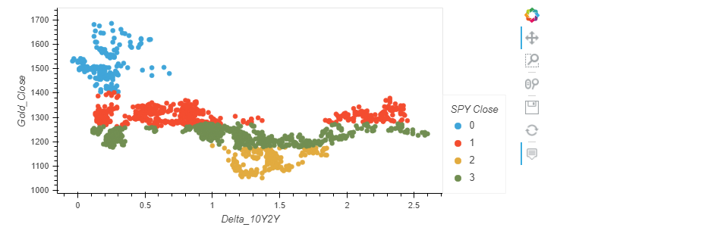
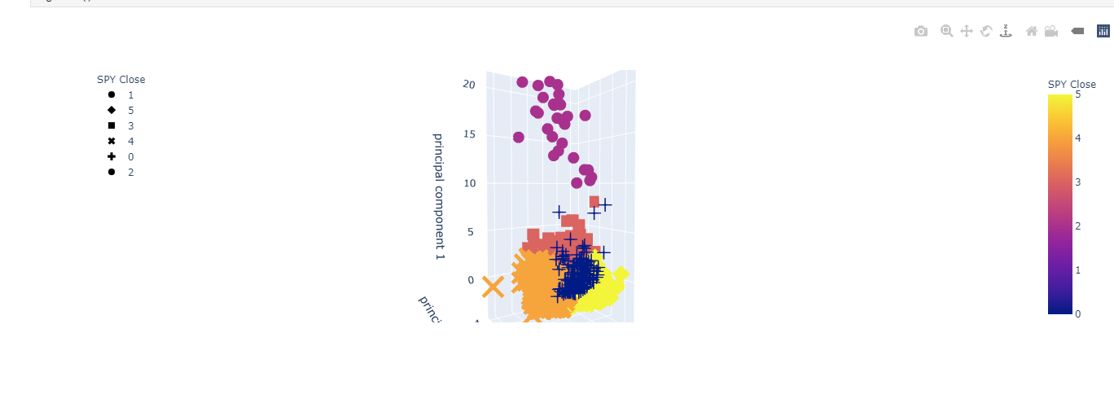
K-means and Initialized 3D-Kmean

Slide 12
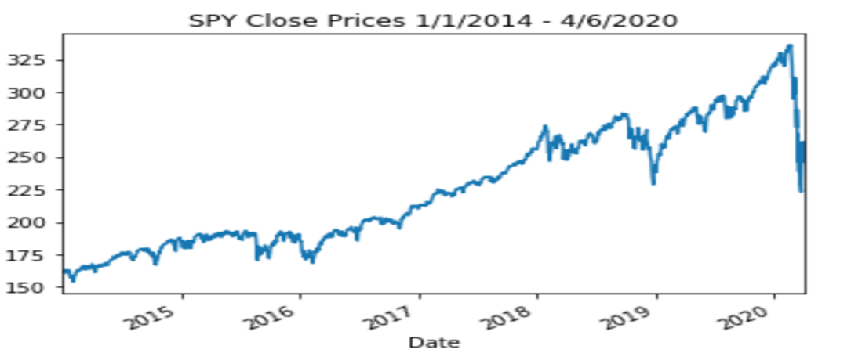
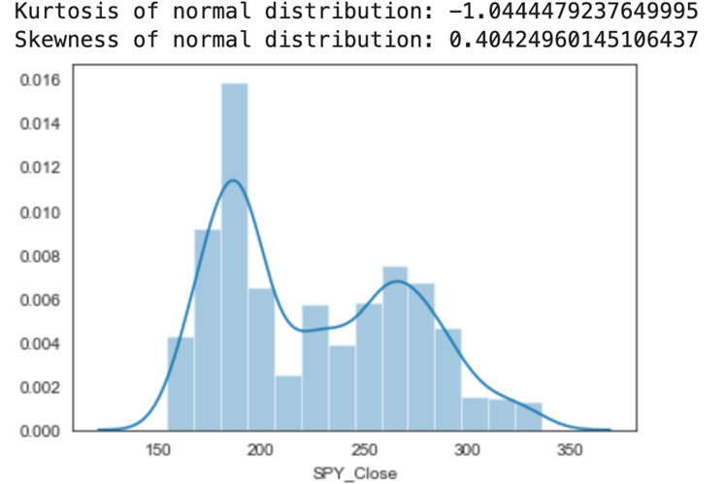
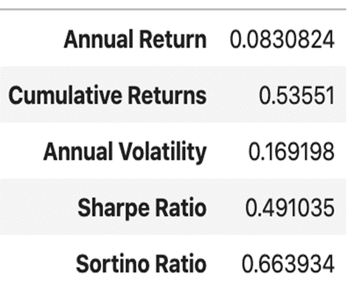
Visualizing S&P 500

Slide 13
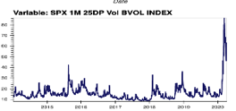
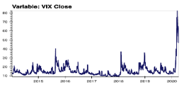
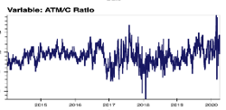
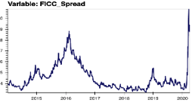
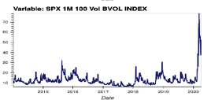
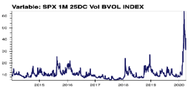
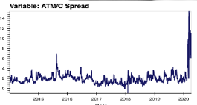
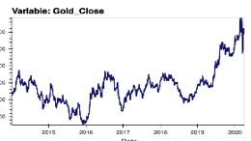
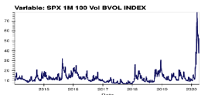
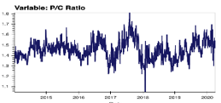
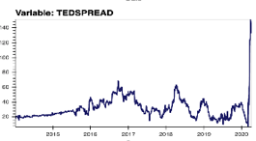
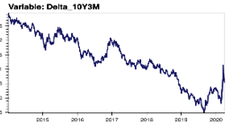
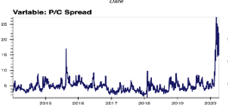
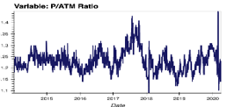
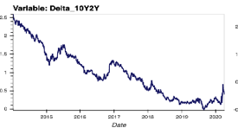
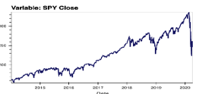
Economic Data

Slide 14

Any Questions?

Slide 15


Thank You

